Slide 1
Topic 3: Tools
Workshop on Building AI Agents
Henry Kautz
Spring 2026

Slide 2
Using LLM Servers
Ollama
Run an open LLM as a separate process
Communicate with your code over an HTTP connection
Default: http://localhost:11434
Does not need to be restarted each time you run your code
Ollama container provides standard API across different LLMs
Commercial LLMs
Run on providers’ optimized infrastructure
Excellent at using tool protocols
Next to SOTA models very cheap

Slide 3
LLMs with Excellent Tool Handling
Open source via Ollama – don’t try on your laptop!
Llama 3.1, 70b
Qwen 2.5, 72b
Nemotron, 70b
Commerical via LangGraph API + access token
GPT-4o $2.50 @ M in $10.00 @ M out
GPT-4o Mini $0.15 @M in $0.60 @M out
Claude 3.5 Sonnet $3.00 @ M in $15.00 @ M out
Claude 3.5 Haiku $0.80 @ M in $4.00 @ M out
Gemini 1.5 Pro $1.25 @ M in $5.00 @ M out
Gemini 1.5 Flash $0.075@ M in $0.19 @ M out

Slide 4
Invoking GPT-4o Mini
from openai import OpenAI
client = OpenAI()
response = client.chat.completions.create(
model="gpt-4o-mini",
messages=[
{"role": "user", "content": "Hello!"}
] )

Slide 5
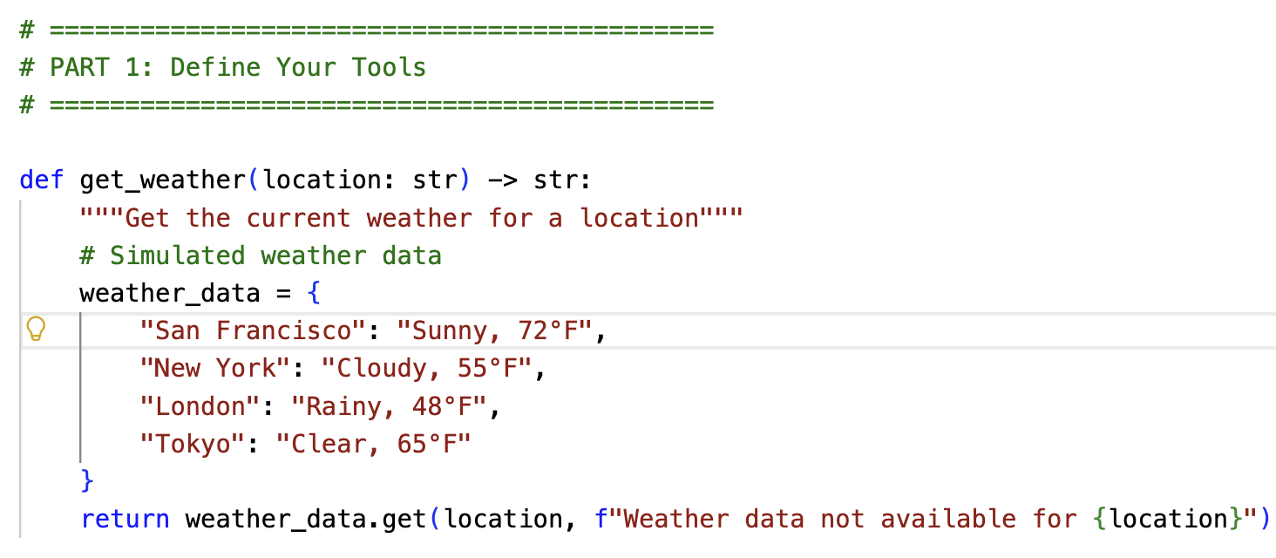
Manual Tool Handling: Define Tools

Slide 6
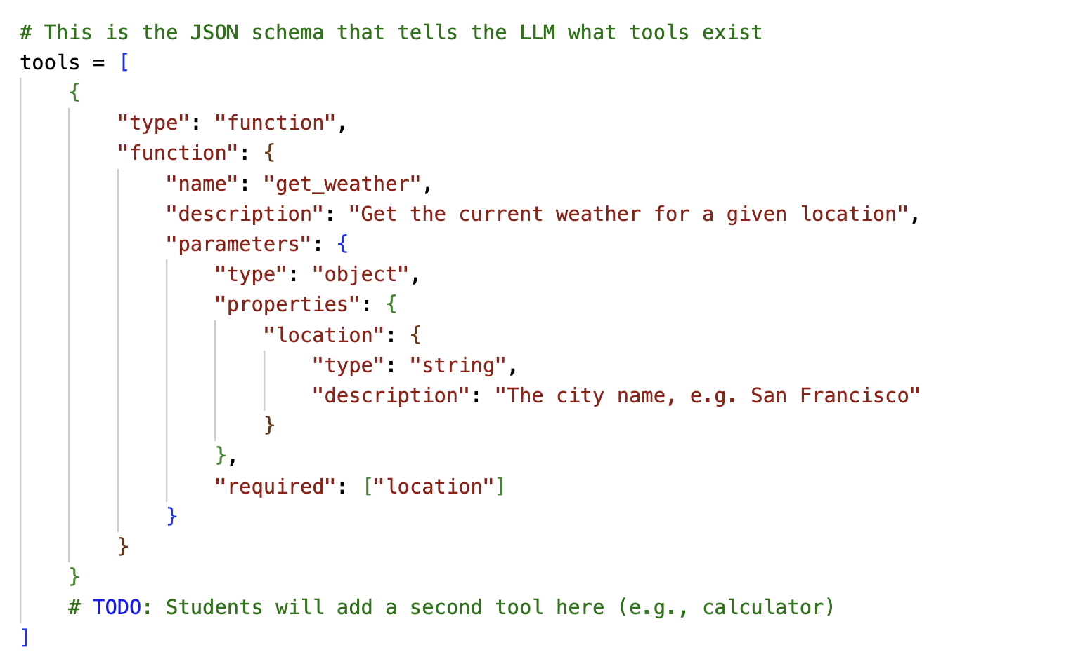
Manual Tool Handling: Describe Tools to LLM

Slide 7
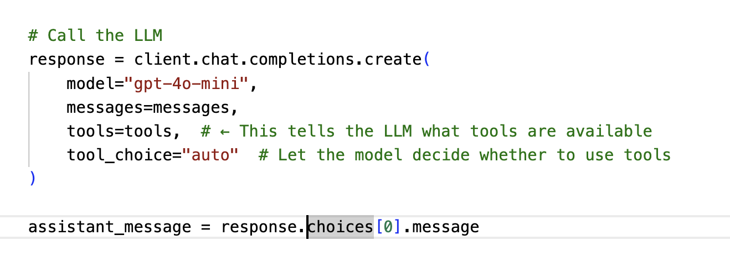
Manual Tool Handling: Calling LLM
The LLM has been trained to understand tool definitions, but exactly how is proprietary. Client.chat.completions passes the tools parameter to the LLM which (somehow) inserts it into the messages sent to the LLM

Slide 8
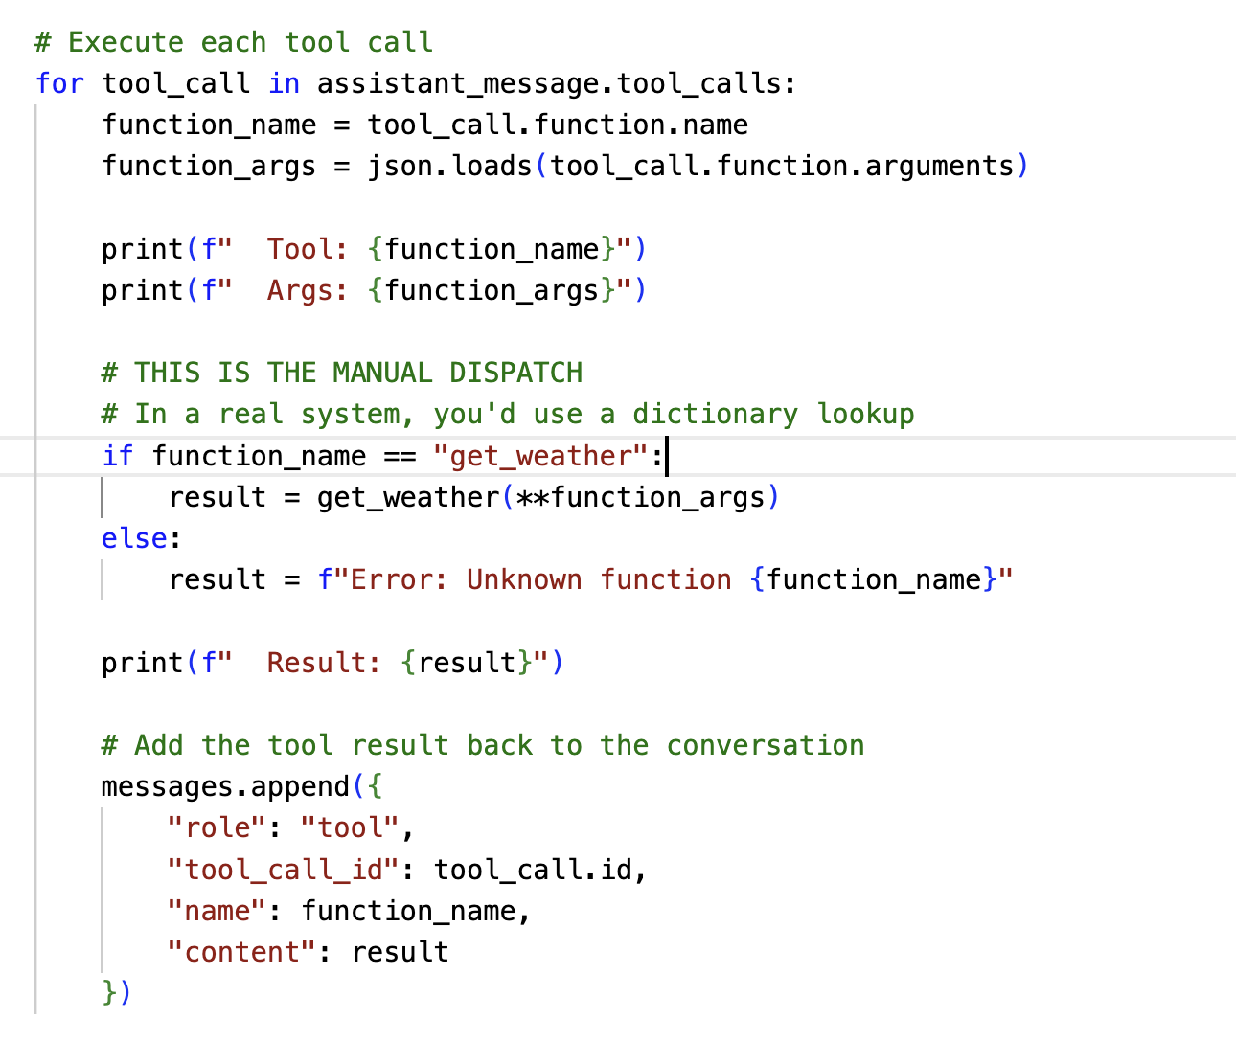
Manual Tool Handling: Execute Tool Calls

Slide 9
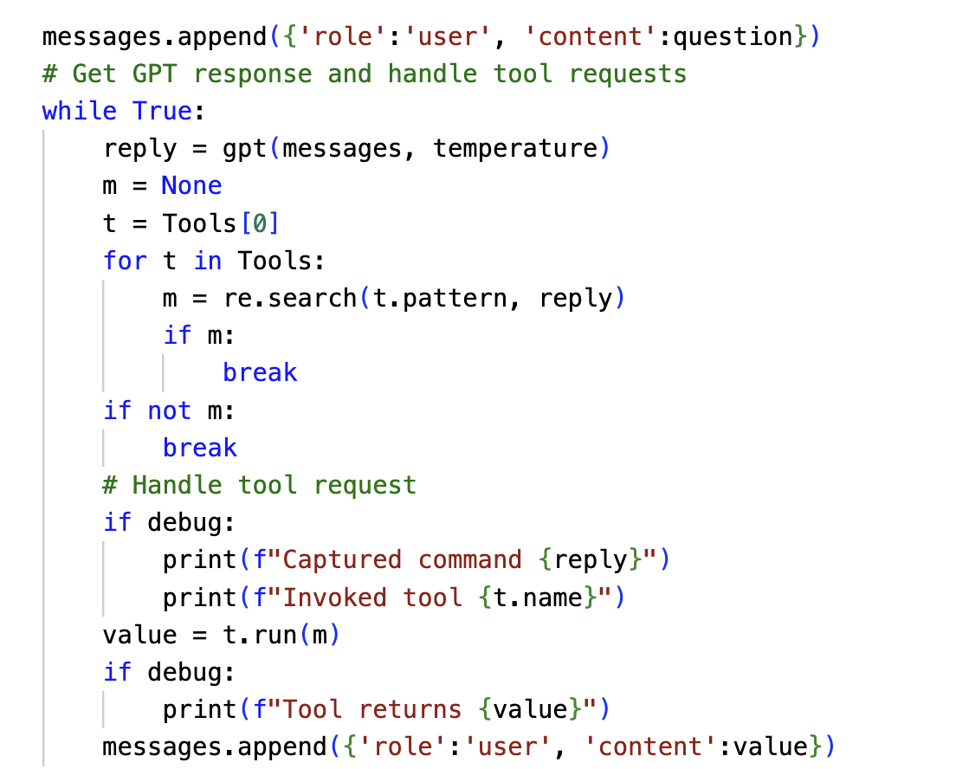
Compare With Pre-Historic gpt_with_tools
Old days: string search for tool call in text output from LLM
Today: LLM has been trained to output tool calls in a special json format
The response object parses response and populates tool_calls field

Slide 10
Work Break
Find your partner(s) from the last class and select a breakout number – see Google Spreadsheet linked to class pages
Complete Tasks 1 to 3

Slide 11

Thursday 29 January

Slide 12
LangGraph Makes Tools Easier
@tool decorator
Automatically creates the data structures associated with a tool
llm.bind_tools( list of tools )
Creates a new tool-using LLM from an existing LLM
Associates the data structures created by @tool with t he LLM
llm.invoke( query_string )
Llm.invoke( [ role_content_dict1, role_content_dict2, … ] )
Runs tool-using LLM
Provides the tool use definitions created by @tool to the LLM
Parses tool calls and populates response.tool_calls

Slide 13
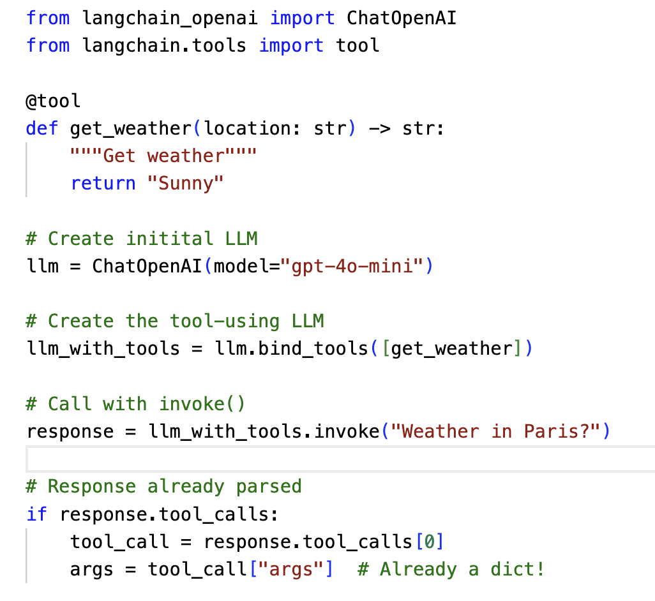
LLM with Tools Example

Slide 14
This is some kind of fun.
Create a tool that counts the number of occurrences of a letter
Find questions that demonstrate multiple tool use
"Are there more i's than s's in Mississippi riverboats?"
Letter count tool for i
Letter count tool for s
Think
Calculator tool
Can you create a query that uses all your tools?
Can you get sequential chaining to hit the 5 turn limit in the outer loop?

Slide 15
Work Break
Complete Task 4

Slide 16
Coming Next Week
ToolNode: Another level of abstraction for writing agents
Built-in LangGraph tools
Connecting to server-based tools

